Slide 1
Software Project Management

Slide 2
Project planning
Once a project is found to be feasible, software project managers undertake project planning.
Project planning is undertaken and completed even before any development activity starts.

Slide 3
Essential activities in Project Planning:
1) Estimating the following attributes of the project:
Project size: What will be problem complexity in terms of the effort and time required to develop the product?
Cost: How much is it going to cost to develop the project?
Duration: How long is it going to take to complete development?
Effort: How much effort would be required?
The effectiveness of the subsequent planning activities is based on the accuracy of these estimations.

Slide 4
2) Scheduling manpower and other resources
3) Staff organization and staffing plans
4) Risk identification, analysis, and abatement planning
5) Miscellaneous plans such as quality assurance plan, configuration management plan, etc.

Slide 5
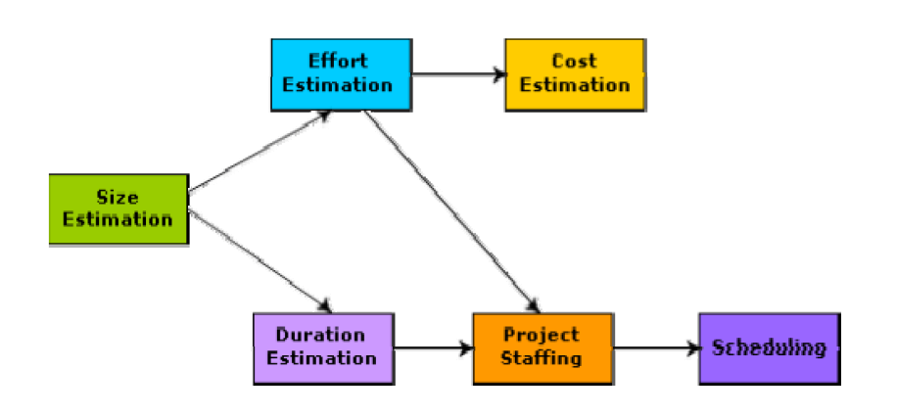
Precedence ordering among project planning activities

Slide 6
Problem in Project Planning
Commitment to unrealistic time and resource estimates result in schedule slippage.
Schedule delays can cause customer dissatisfaction and adversely affect team morale.
However, project planning is a very challenging activity. Especially for large projects, it is very much difficult to make accurate plans.
A part of this difficulty is due to the fact that the proper parameters, scope of the project, project staff, etc. may change during the span of the project.

Slide 7
Solution: Sliding Window Planning
Planning a project over a number of stages protects managers from making big commitments too early.
This technique of staggered planning is known as Sliding Window Planning.
Starting with an initial plan, the project is planned more accurately in successive development stages.
After the completion of every phase, the project managers can plan each subsequent phase more accurately and with increasing levels of confidence.

Slide 8
Responsibilities of a software project manager
Overall responsibility of steering a project to success.
The job responsibility of a project manager ranges from invisible activities like building up team morale to highly visible customer presentations.
Activities can be broadly classified into project planning, and project monitoring and control activities.
It includes:
project proposal writing, project cost estimation, scheduling, project staffing, software process tailoring, project monitoring and control, software configuration management, risk management, interfacing with clients, managerial report writing and presentations, etc.

Slide 9
Skills necessary for software project management
Theoretical knowledge of different project management techniques like cost estimation, risk management, configuration management
Good qualitative judgment and decision taking capabilities.
Good communication skills and the ability get work done.

Slide 10
Software Project Management Plan (SPMP)
1. Introduction
(a) Objectives
(b) Major Functions
(c) Performance Issues
(d) Management and Technical Constraints
2. Project Estimates
(a) Historical Data Used
(b) Estimation Techniques Used
(c) Effort, Resource, Cost, and Project Duration Estimates
3. Schedule
(a) Work Breakdown Structure
(b) Task Network Representation
(c) Gantt Chart Representation
(d) PERT Chart Representation

Slide 11
Software Project Management Plan (SPMP)
4. Project Resources
(a) People
(b) Hardware and Software
(c) Special Resources
5. Staff Organization
(a) Team Structure
(b) Management Reporting
6. Risk Management Plan
(a) Risk Analysis
(b) Risk Identification
(c) Risk Estimation
(d) Risk Abatement Procedures
7. Project Tracking and Control Plan
8. Miscellaneous Plans
(a) Process Tailoring
(b) Quality Assurance Plan
(c) Configuration Management Plan

Slide 12
Project Estimation techniques
Empirical estimation techniques
Heuristic techniques
Analytical estimation techniques

Slide 13
Empirical Estimation Techniques
Based on making an educated guess of the project parameters.
Prior experience with development of similar products is helpful.
Although empirical estimation techniques are based on common sense, different activities involved in estimation have been formalized over the years.
Two popular empirical estimation techniques are: 1) Expert judgment technique
2) Delphi cost estimation

Slide 14
Expert Judgment Technique
An expert makes an educated guess of the problem size after analyzing the problem thoroughly.
Estimates the cost of the different components (i.e. modules or subsystems) of the system and then combines them to arrive at the overall estimate.
However, this technique is subject to human errors and individual bias.
For example, he may be conversant with the database and user interface parts but may not be very knowledgeable about the computer communication part.
A more refined form of expert judgment is the estimation made by group of experts.

Slide 15
Delphi cost estimation
It overcomes some of the shortcomings of the expert judgment approach.
Delphi estimation is carried out by a team comprising of a group of experts and a coordinator.
No discussion among the estimators is allowed during the entire estimation process.

Slide 16
Delphi cost estimation
The coordinator provides each estimator with a copy of the SRS document and a form for recording his cost estimate.
Estimators complete their individual estimates anonymously and submit to the coordinator.
The coordinator prepares and distributes the summary of the responses of all the estimators, and includes any unusual rationale noted by any of the estimators.
Based on this summary, the estimators re-estimate.
This process is iterated for several rounds.

Slide 17
Heuristic Techniques
It assumes that the relationships among the different project parameters can be modelled using suitable mathematical expressions.
Once the basic (independent) parameters are known, the other (dependent) parameters can be easily determined by substituting the value of the basic parameters in the mathematical expression.
Two classes:
1) single variable model and
2) multi variable model

Slide 18

Single variable estimation models
It provides a means to estimate the desired characteristics of a problem, using some previously estimated basic (independent) characteristic of the software product such as its size.
Estimated Parameter =
e is the characteristic of the software which has already been estimated (independent variable)
c1 and d1 are constants determined using data collected from past projects (historical data).

Slide 19
Multivariable cost estimation model
Where e1, e2, … are the basic (independent) characteristics of the software already estimated, and c1, c2, d1, d2, … are constants.
Multivariable estimation models are expected to give more accurate estimates.

Slide 20
Project Types
Organic:
Routine project
Well understood domain
Team works well and efficiently together
Project expected to run smoothly
Typically a smaller system and smaller team
Embedded:
Difficulties expected
Project that is hard (control software for a nuclear plant, or spacecraft)
Team has little experience in domain
New or inexperienced team
Tend to be large projects with lots of constraints

Slide 21
Semidetached:
In the middle
Complex system, but something the company is familiar with
Teams may be made up of experienced and inexperienced members
System not huge, but not small either

Slide 22
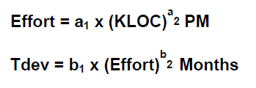
Basic COCOMO Model
COnstructive COst MOdel
The basic COCOMO model gives an approximate estimate of the project parameters.

Slide 23
person-months (PM).
The effort estimation is expressed in units of person-months (PM).
An effort of 100 PM does not imply that 100 persons should work for 1 month nor does it imply that 1 person should be employed for 100 months, but it denotes the area under the person-month curve .
It is the area under the person-month plot.

Slide 24
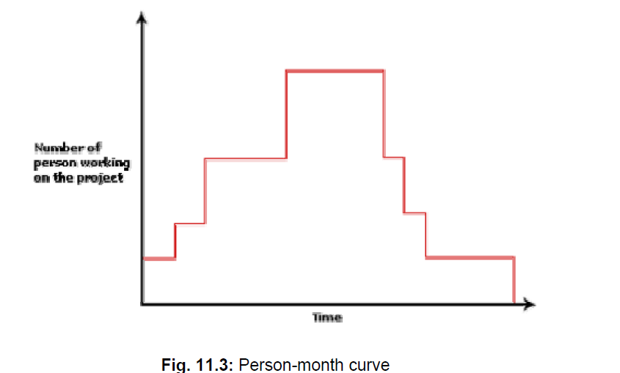
person-months (PM)

Slide 25

Estimation of development effort

Slide 26
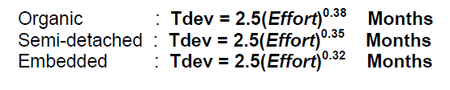
Estimation of development time

Slide 27
Example:
Assume that the size of an organic type software product has been estimated to be 32,000 lines of source code. Assume that the average salary of software engineers be Rs. 15,000/- per month. Determine the effort required to develop the software product and the nominal development time.

Slide 28



Slide 29
Example:- Suppose a project was estimated to be 400 KLOC. Calculate the effort and development time for each of the three model i.e., organic, semi-detached & embedded.
Example:- A project size of 200 KLOC is to be developed. Software development team has average experience on similar type of projects. The project schedule is not very tight. Calculate the Effort, development time, average staff size, and productivity of the project.

Slide 30
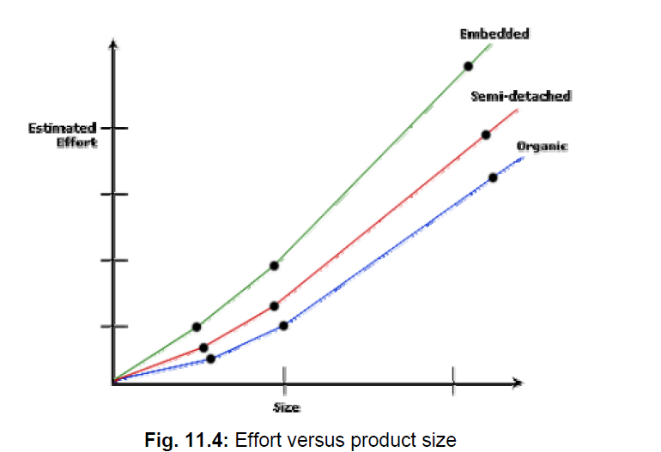

Slide 31
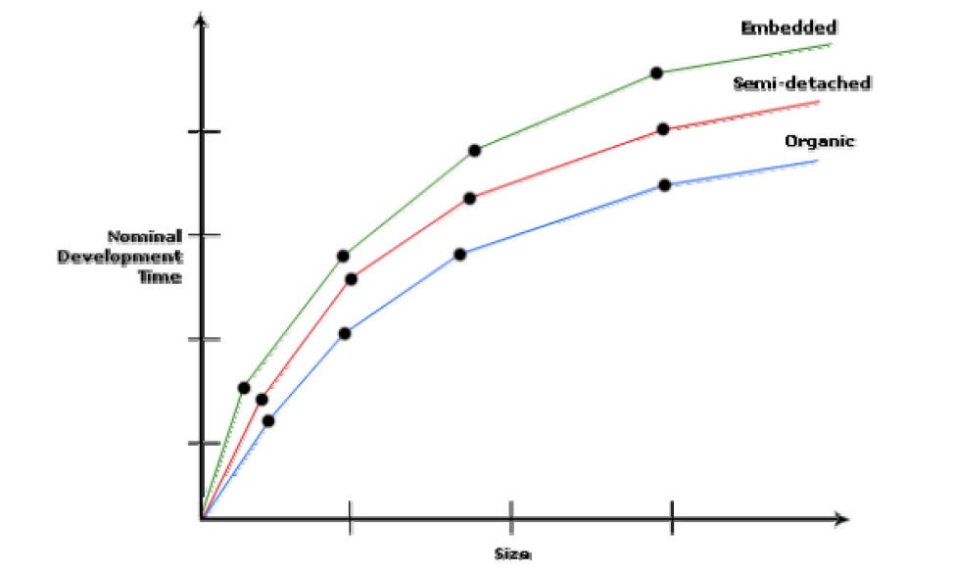

Slide 32
Intermediate COCOMO model
The basic COCOMO model assumes that effort and development time are functions of the product size alone.
However, a host of other project parameters besides the product size affect the effort required to develop the product as well as the development time.
Therefore, in order to obtain an accurate estimation of the effort and project duration, the effect of all relevant parameters must be taken into account.

Slide 33
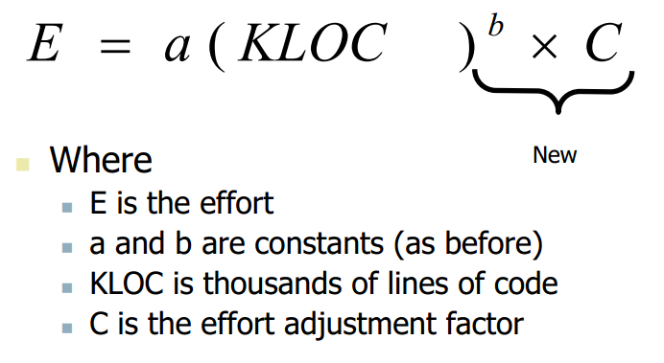

Slide 34
15 Cost Drivers
Boehm requires the project manager to rate these 15 different parameters for a particular project on a scale of one to three.
Then, depending on these ratings, he suggests appropriate cost driver values which should be multiplied with the initial estimate obtained using the basic COCOMO.

Slide 35
Classification of Cost Drivers
Product: The characteristics of the product that are considered include the inherent complexity of the product, reliability requirements of the product, etc.
Computer: Characteristics of the computer that are considered include the execution speed required, storage space required etc.
Personnel: The attributes of development personnel that are considered include the experience level of personnel, programming capability, analysis capability, etc.
Development Environment: Development environment attributes capture the development facilities available to the developers. An important parameter that is considered is the sophistication of the automation (CASE) tools used for software development.

Slide 36
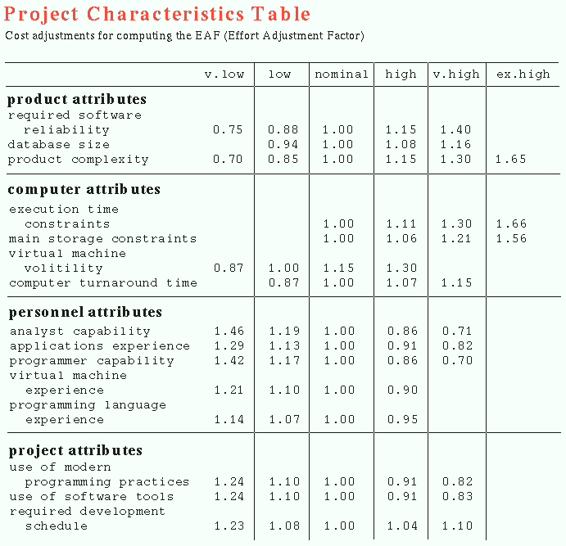

Slide 37
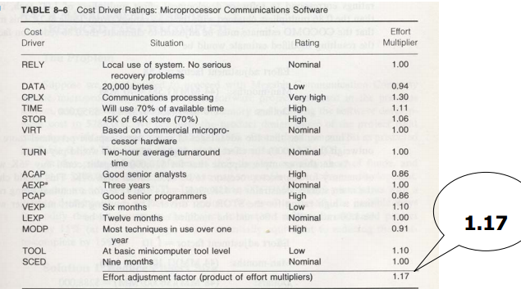

Slide 38
Complete COCOMO model
A major shortcoming of both the basic and intermediate COCOMO models is that they consider a software product as a single homogeneous entity.
However, most large systems are made up several smaller sub-systems.
These subsystems may have widely different characteristics.
For example, some subsystems may be considered as organic type, some semidetached, and some embedded.

Slide 39
Example
A distributed Management Information System (MIS) product for an organization having offices at several places across the country can have the following sub-components:
• Database part
• Graphical User Interface (GUI) part
• Communication part
Of these, the communication part can be considered as embedded software.
The database part could be semi-detached software, and the GUI part organic software.

Slide 40
Staffing level estimation
Once the effort required to develop a software has been determined, it is necessary to determine the staffing requirement for the project.
Norden and Putnam studied the staffing patterns of several R & D projects.

Slide 41
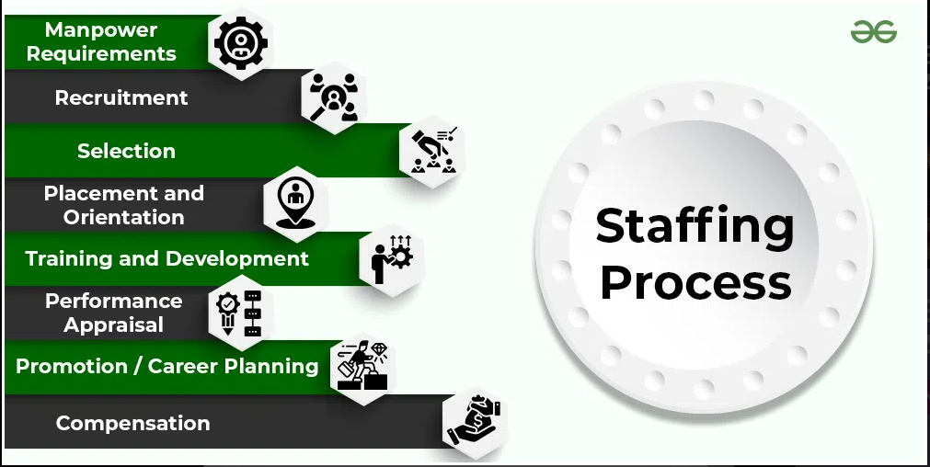

Slide 42

Norden’s Work
He found that the staffing pattern can be approximated by the Rayleigh distribution curve.
Norden represented the Rayleigh curve by the following equation:
E is the effort required at time t. E is an indication of the number of engineers (or the staffing level) at any particular time during the duration of the project
K is the area under the curve, and
td is the time at which the curve attains its maximum value.

Slide 43
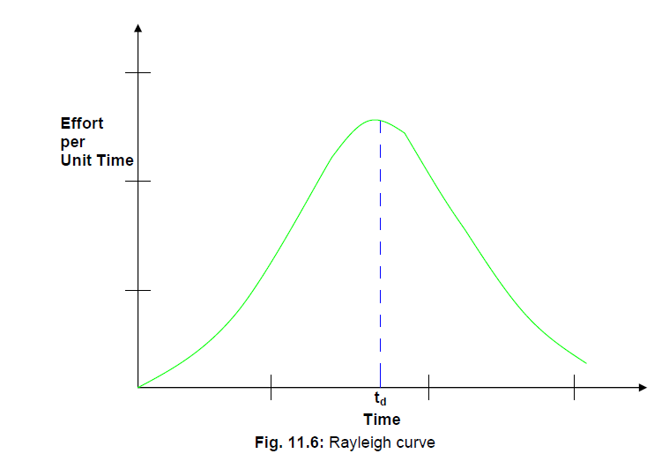

Slide 44
Project scheduling
It involves deciding which tasks would be taken up when. Activities undertaken:
1. Identify all the tasks needed to complete the project.
2. Break down large tasks into small activities.
3. Determine the dependency among different activities.
4. Establish the most likely estimates for the time durations necessary to complete the activities.
5. Allocate resources to activities.
6. Plan the starting and ending dates for various activities.
7. Determine the critical path. A critical path is the chain of activities that determines the duration of the project.

Slide 45
Work breakdown structure
Work Breakdown Structure (WBS) is used to decompose a given task set recursively into small activities.
The root of the tree is labeled by the problem name.
Each node of the tree is broken down into smaller activities that are made the children of the node.
Each activity is recursively decomposed into smaller sub-activities until at the leaf level, the activities requires approximately two weeks to develop.

Slide 46
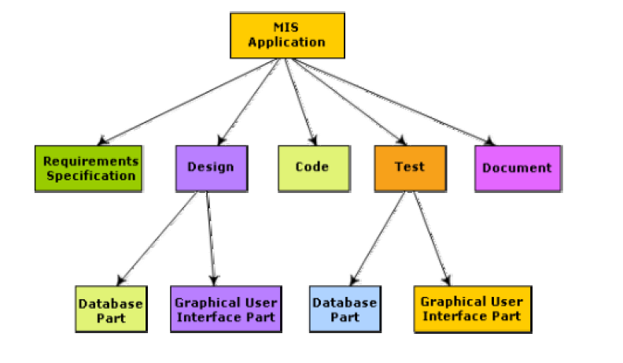
Work breakdown structure of MIS problem

Slide 47
Activity networks and critical path method
WBS representation of a project is transformed into an activity network by representing activities identified in WBS along with their interdependencies.
An activity network shows the different activities making up a project, their estimated durations, and interdependencies.

Slide 48
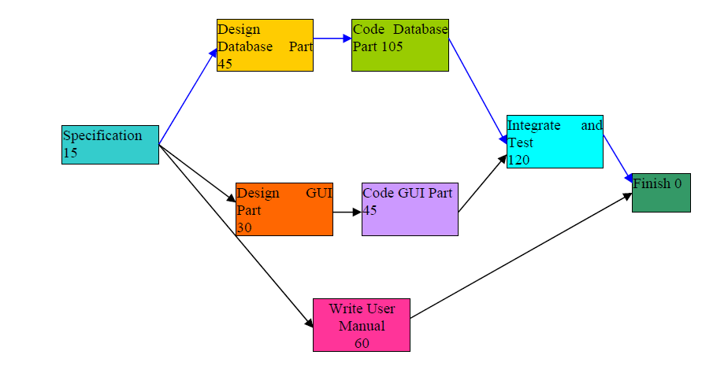
Activity network representation of the MIS problem

Slide 49
Critical Path Method (CPM)
The minimum time (MT) to complete the project is the maximum of all paths from start to finish.
The earliest start (ES) time of a task is the maximum of all paths from the start to the task.
The latest start time is the difference between MT and the maximum of all paths from this task to the finish.
The earliest finish time (EF) of a task is the sum of the earliest start time of the task and the duration of the task.
The latest finish (LF) time of a task can be obtained by subtracting maximum of all paths from this task to finish from MT.
The slack time (ST) is LS – EF and equivalently can be written as LF – EF.

Slide 50
Activity | Duration | Precede
A | 6 | -
B | 4 | -
C | 3 | A
D | 4 | B
E | 3 | B
F | 10 | -
G | 3 | E, F
H | 2 | C, D

Slide 51
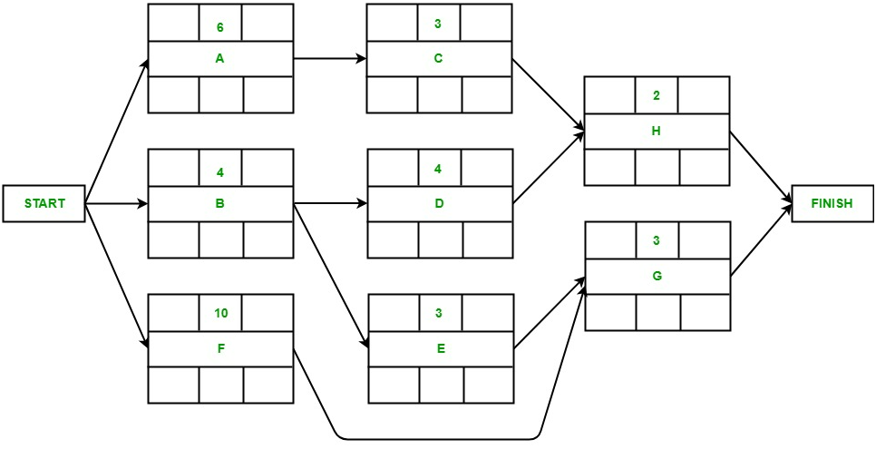

Slide 52
Activity | Duration | Precede
A | 5 | -
B | 4 | A
C | 5 | A
D | 6 | B
E | 3 | C
F | 4 | D, E

Slide 53
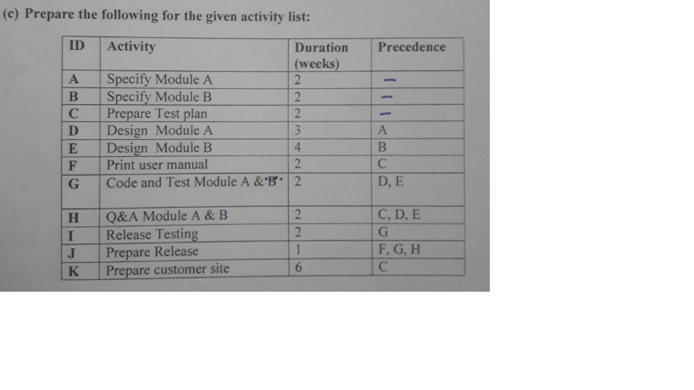
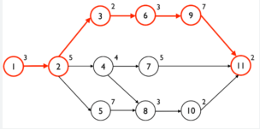
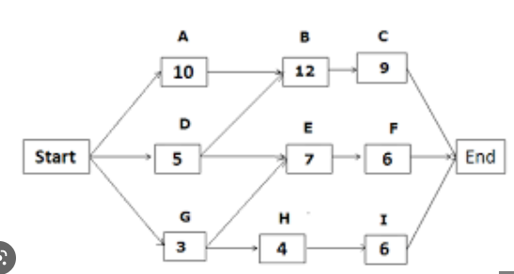

Slide 54
Slack Time
The slack time (or float time) is the total time that a task may be delayed before it will affect the end time of the project.
The slack time indicates the “flexibility” in starting and completion of tasks.
A critical task is one with a zero slack time. A path from the start node to the finish node containing only critical tasks is called a critical path.

Slide 55
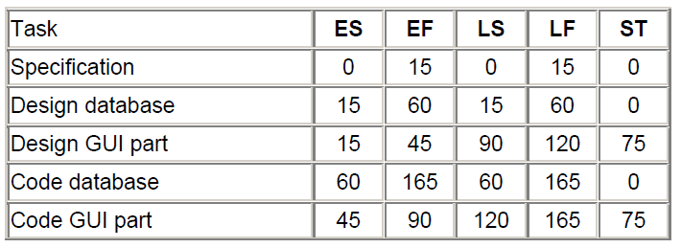

Parameters for different tasks of MIS Problem

Slide 56
Gantt chart
Used to allocate resources to activities (resource planning).
The resources allocated to activities include staff, hardware, and software.
A Gantt chart is a special type of bar chart where each bar represents an activity.
The bars are drawn along a time line.
The length of each bar is proportional to the duration of time planned for the corresponding activity.

Slide 57
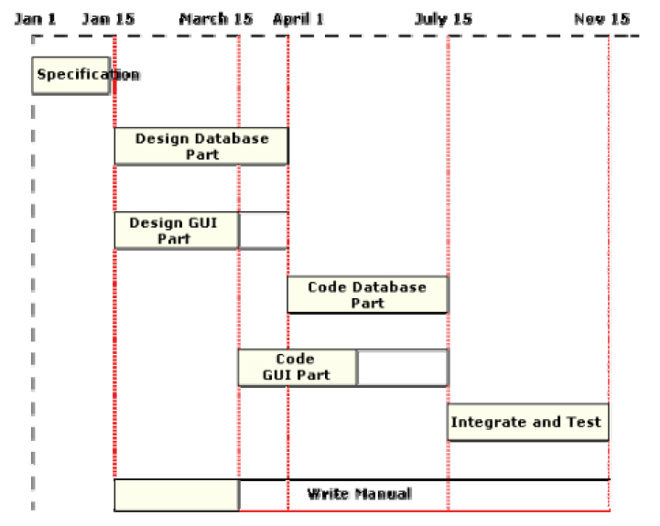
Gantt chart for MIS problem

Slide 58
PERT chart
PERT (Program Evaluation and Review Technique) charts consist of a network of boxes and arrows.
The boxes represent activities and the arrows represent task dependencies.
The boxes of PERT charts are usually annotated with the pessimistic, likely, and optimistic estimates for every task.

Slide 59
Gantt chart representation of a project schedule is helpful in planning the utilization of resources, while PERT chart is useful for monitoring the timely progress of activities.
Also, it is easier to identify parallel activities in a project using a PERT chart.

Slide 60
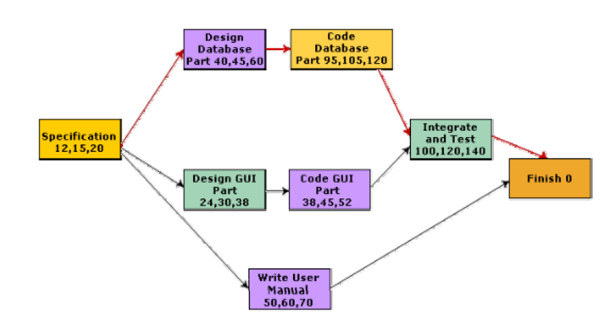
PERT chart representation of the MIS problem

